Slide 1
Chapter 5 Induction and Recursion
Section 4
Recursive Algorithms

Slide 2
Outline
Introduction - Recursive Algorithms
Proving Recursive Algorithms Correct

Slide 3
Recursive Algorithms
Definition. (Recursive Algorithms)
  An algorithm is called recursive if it solves a problem by reducing it to an instance of the same problem with smaller input
Remark.
  Give a recursive algorithm for computing n! where n is a non-negative integer
    We can compute n!=n∙(n-1)! Where n is a positive integer, and that 0!=1 for a particular integer
    We use the recursive step n times

Slide 4
Recursive Algorithms
Example.
  Recursive algorithm for n!
  procedure factorial(n: non-negative integer)
  if n=0 then factorial(n):=1
  else factorial(n):=n ∙ factorial(n-1)

Slide 5
Recursive Algorithms
Example.
  Recursive algorithm for a^{n}
  procedure power(a: nonzero real number, n: non-negative integer)
  if n=0 then power(a,n):=1
  else power(a,n):=a * power(a, n-1)

Slide 6
Recursive Algorithms
Example.
  Formulate a recursive algorithm for computing b^{n} mod m, where b, n and m are integers with m≥2, n≥0, 1≤b<m
  Solution.
  Let m be a positive integer and let a and b be integers, then
  (a+b) mod m=((a mod m) + (b mod m)) mod m
  ab mod m = ((a mod m)(b mod m)) mod m
  Thus,
  b^{n} mod m = (b (b^{n-1} mod m)) mod m, and
  b⁰ mod m = 1

Slide 7
Recursive Algorithms
Remark.
  However, we can have a more efficient recursive algorithm
  b^{n} mod m = (b^{n/2} mod m)² mod m, when n is even
  b^{n} mod m = (b^{⎣n/2⎦})² b) mod m, when n is odd
  = (((b^{⎣n/2⎦} mod m)² mod m)⋅(b mod m)) mod m
  procedure mpower(b, n, m: integers with m≥2, n≥0)
  if n=0 then
  mpower(b, n, m):=1
  else if n is even then
  mpower(b, n, m):=mpower(b, n/2, m)² mod m
  else
  mpower(b, n, m):=mpower(b, ⎣n/2⎦, m)² mod m * b mod m) mod m
  {mpower(b, n, m)=b^{n} mod m}

Slide 8
Recursive Algorithms
Remark.
  Trace the above algorithm with b=2, n=5, and m=3
  Since n is odd, we have mpower(2, 5, 3) = (mpower(2,2,3)² mod 3 ∙ 2 mod 3) mod 3
  Next, mpower(2,2,3)=mpower(2,1,3)² mod 3, and mpower(2,1,3)= (mpower(2,0,3)² mod 3 ∙ 2 mod 3) mod 3, and mpower(2,0,3)=1
  So, mpower(2,1,3)=(1² mod 3 ∙ 2 mod 3) mod 3 = 2
  So, power(2, 2, 3)=2² mod 3 =1 and finally mpower(2, 5, 3)=(1² mod 3 ∙ 2 mod 3) mod 3 =2

Slide 9
Recursive Algorithms
Example.
  Give a recursive algorithm for gcd(a, b) with a<b
  A recursive version of Euclidean algorithm
    procedure gcd(a, b: non-negative integers with a < b)
    if a=0 then
    gcd(a, b):=b
    else
    gcd(a, b):=gcd(b mod a, a)
  Let a=5 and b=8. gcd(5, 8)=gcd(8 mod 5, 5)=gcd(3, 5)
  Next, gcd(3, 5)=gcd(5 mod 3, 3)=gcd(2, 3), then gcd(2, 3)=gcd (3 mod 2, 2)=gcd(1, 2). Finally gcd(1,2)=gcd(2 mod 1, 2) = gcd(0, 1)=1. Thus, gcd(5,8)=1

Slide 10
Recursive Algorithms
Example.
  Binary Search Algorithm
  procedure binary_search(i, j, x: integers, 1≤i≤n, 1≤j≤n)
  m= ⎣(i+j)/2⎦
  if x=a_{m} then
  location:=m
  else if (x < a_{m} and i < m) then
  binary_search(x, i, m-1)
  else if (x > a_{m} and j > m) then
  binary_search(x, m+1, j)
  else
  location:=0

Slide 11
Proving Recursive Algorithm
Example.
  Prove that the recursive algorithm power(a, n) is correct
  procedure power(a: nonzero real number, n: non-negative integer)
  if n=0 then power(a,n):=1
  else power(a,n):=a * power(a, n-1)
  Basis step: If n=0, power(a,0)=1. This is correct as a⁰=1
  Inductive step: The inductive hypothesis is power(a,k)=a^{k} for a≠0 and non-negative k. To complete the proof, we need to show power(a,k+1)= a^{k+1}
  As k+1 is a positive integer, the algorithms sets power(a, k+1)=a ∙ power(a, k)=a∙a^{k} = a^{k+1}
  This completes the inductive step

Slide 12
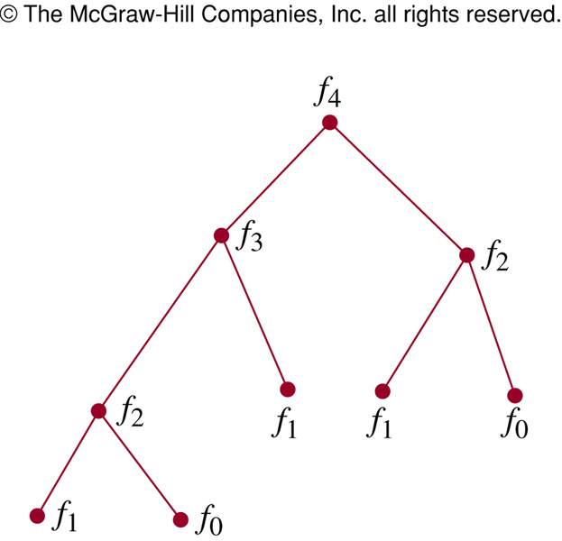
Recursion and Iteration
Example. (Fibonacci)
  Often an iterative algorithm (迭代算法) is more efficient than a recursive one (unless special-purpose machines are used)
  procedure fibonacci(n: nonzero integer)
  if n=0 then fibonacci(n):=0
  else if n=1 then fibonacci(1):=1
  else fibonacci(n):=fibonacci(n-1)+fibonacci(n-2)
  fibonacci(4)

Slide 13
Recursion and Iteration
  Iterative Algorithm for Fibonacci Number
  procedure iterative_fibonacci(n: nonzero integer)
  if n=0 then y:=0
  else
  begin
  x:=0
  y:=1
  for i:=1 to n-1
  z:=x+y
  x:=y
  y:=z
  end
  end
  {y is the n-th Fibonacci number}

Slide 14
Recursion and Iteration
  The above algorithm initializes x as f₀=0, and y as f₁=1
  When the loop is traversed, the sum of x and y is assigned to the auxiliary variable z
  Then x is assigned the value of y and y is assigned the value of the auxiliary variable z
  Thus, after going through the loop the first time, it follows x equals f₁ and y equals f₀+f₁=f₂
  Next, f₁+f₂=f₃, …
  After going through the algorithm n-1 times, x equals f_{n-1} and y equals f_{n}
  Only n-1 additions have been used to find f_{n}

Slide 15
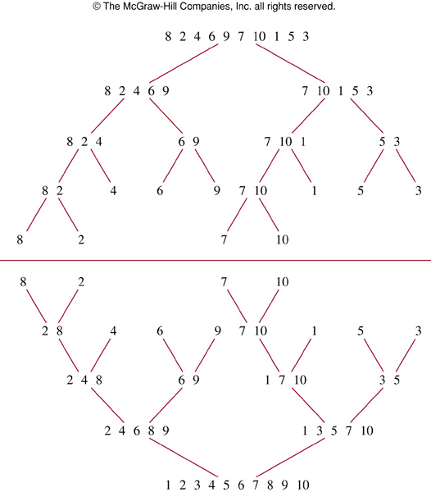
Recursion and Iteration
Example. (Merge Sort)
  Sort the list 8, 2, 4, 6, 9, 7, 10, 1, 5, 3
  The merge sort: split the list into individual elements by successively splitting lists into two
  Sorting is done by successively merging pairs of lists

Slide 16
Recursion and Iteration
Example. (Merge Sort)
  In general, a merge sort proceeds by iteratively splitting lists into two sublists
  We can also describe the merge sort recursively
  procedure mergesort(L=a₁, …, a_{n})
  if n>1 then
  m:= ⎣n/2⎦
  L₁:=a₁, a₂, …, a_{m}
  L₂:=a_{m+1}, …, a_{n}
  L:=merge(mergesort(L₁), mergesort(L₂))
  {L is a sorted list in non-decreasing order}

Slide 17
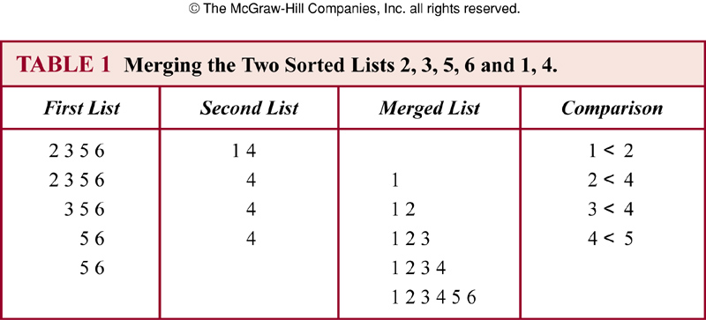
Recursion and Iteration
Example. (Merge Sort)
  Merge two lists, 2, 3, 5, 6, and 1, 4

Slide 18
Recursion and Iteration
Example. (Merge Sort)
  procedure merge(L₁, L₂: sorted lists)
  L:=empty set
  while L₁and L₂ are both non-empty
  begin
  remove smaller of first element of L₁ and L₂ from the list it is in and put it at the right end of L
  if removal of this element makes one list empty then remove all elements from the other list and append them to L
  end
  {L is a sorted list in non-decreasing order}

Slide 19
Recursion and Iteration
Lemma.
  Two sorted lists with m elements and n elements can be merged into a sorted list using no more than m+n-1 comparisons
Theorem.
  The number of comparisons needed to merge sort a list with n elements is O(nlogn)

Slide 20
Assignment
Exercises after 4.4: No.8, 44 (Ver.6)
Exercises after 5.4: No.(Ver.7)

